Slide 1
Dealing with Digital Natives
Rob Honomichl – Dakota State University

Slide 2
Marc Prensky and Digital Natives
Some argue, the students aren't "really" native speakers of the digital language of computers, cell phones, video games and the Internet. In fact they argue, often their students know very little about technology. If that's true, I say shame on the adult for not ensuring students have the access they need to be fully immersed in today's digital environment.
When it comes to being a Digital Native or Digital Immigrant, the reality is that it is less about when you were born and more about how you engage in our digital world today.

Slide 3
Let’s talk about your students
Cellphone
How old were you when you got your first Cellphone?
How many cellphones have you owned (not including losing or breaking)?
Do you still have a landline phone?
What age do you think a kid should get a cellphone?
Do you have a smartphone, does your kid have a smartphone?

Slide 4
Why we live on our phones.
Email
Facebook
Twitter
Foursquare
Barcode Scanners
We don’t like to talk
Guess what, it does as much or more as my computer does.

Slide 5
Let’s talk about computers
What year did you get your first computer in your home?
What year did you get internet at your home?
Dialup or BroadBand
Do you remember the specs of your first computer?

Slide 6
What would you give up first?
Cable TV or Internet

Slide 7
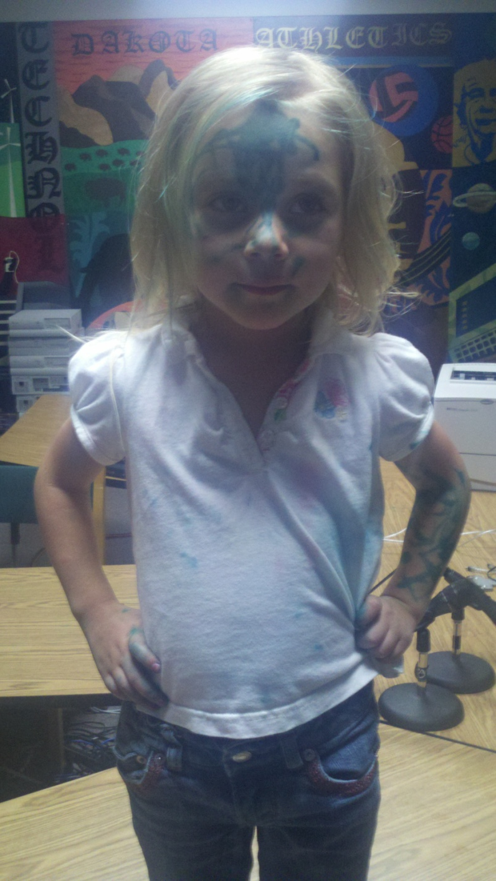
Ok, so why the hell does this matter.
I want to tell you a story of my 3 year old.
What will she be like when she is in school? What do we do to make education relevant to her?

Slide 8
What the C is the cloud?
We use to call this the internet, however this has become a buzz word. I like to call it someone else stores you stuff on their stuff instead of you storing it on your stuff.
Dropbox
Google Docs
Office Online
SkyDrive
Well and just about anything web 2.0

Slide 9
What the F is FourSquare?
Not for the playground
How is it being used in technology, business, and marketing?
Why do we care about telling people where we are or where we go?

Slide 10
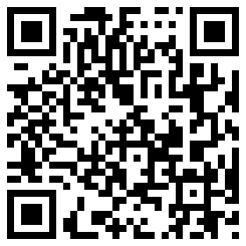
What the Q is a QR Code?
You see them everywhere.
How can my students use them?
How do I make them?
How do I use them?
http://kaywa.com

Slide 11
We Are Mobile…Let’s Embrace It
AirCards
iPads
Laptops/Netbooks
Smartphones
iPods
Do we fight the change of personal portable technology or do we embrace it and find a way to use it in the classroom?

